Slide 1
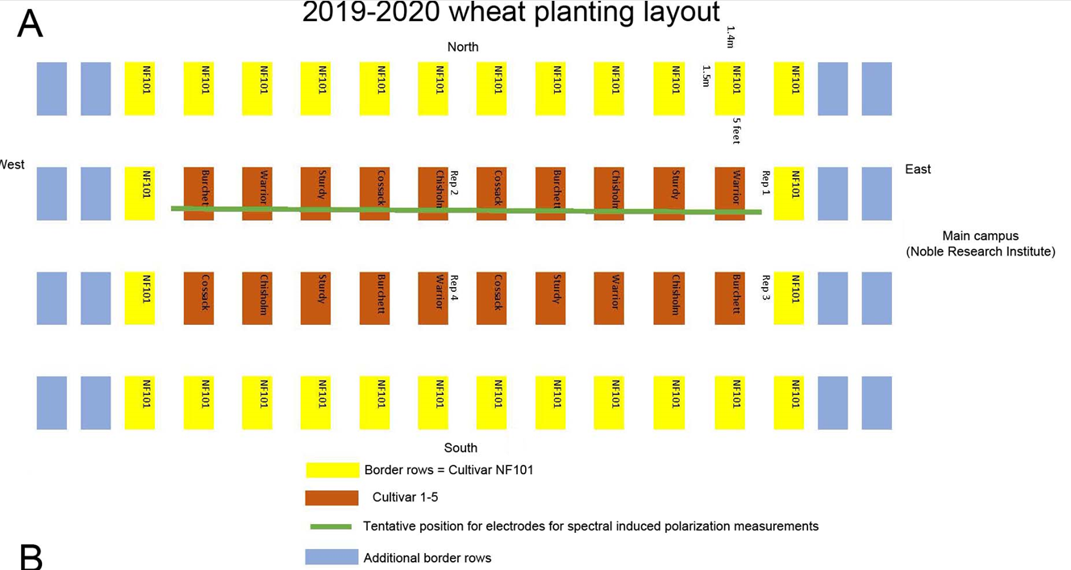
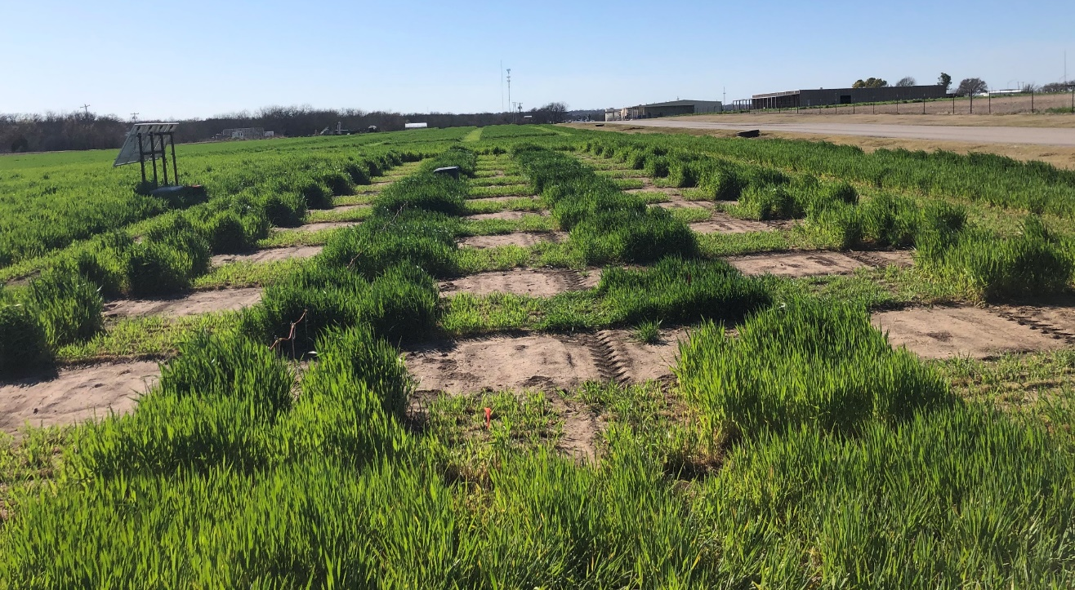
Field map
Field picture
400 W solar panels
& batteries
ERT system

Slide 2
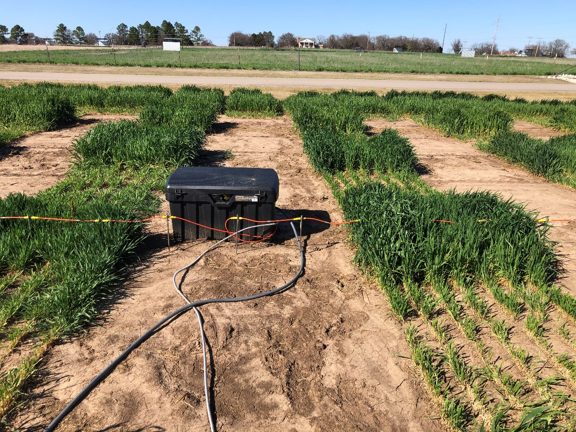
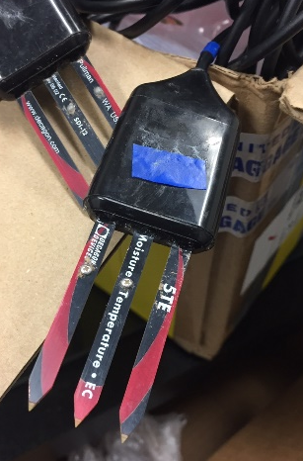
Temperature (TM) hole, 4 sensors
Moisture hole, 2 sensors
ERT
20 cm
20 cm
Electric sensor line
4 TM sensors
Question3: directly Insert these 4 TM sensors to the soil by hand, correct?
Question4: the distance of these two hole will keep around 1-2 feet is OK?
40 cm
40 cm
Location A
Location B
Note: Two moisture sensors need to be firstly covered by native soil, 20 cm and 40 cm, respectively, before refill the hole.
60 cm
Question1: which location is your prefer, we suggest Location B is better than the barren location A because it is wheat area.
Question 2: how far need to be keep from the electric sensor line to the holes which we will dig? 2 feet?
80 cm

